Slide 1
CareSelect Imaging
Clinical Decision Support
Open Access Portal

Slide 2
CareSelect Imaging – Clinical Decision Support
The CareSelect Imaging Open Access Portal is a web version of National Decision Support Company’s (NDSC) qualified Clinical Decision Support Mechanism (qCDSM).
  Enables the use of Appropriate Use Criteria (AUC)
North Oaks Health System has chosen NDSC’s Open Access Portal to provide all ordering providers with access to clinical decision support (CDS), regardless of access to an EMR integrated CDS solution.
The Open Access Portal enables providers to fulfill the Protecting Access to Medicare Act (PAMA) legislative requirement that a CDS consultation must be done at the point of ordering for all high-tech imaging orders. The Open Access Portal does not use Protected Health Information (PHI) in any form.
Visit the North Oaks CareSelect website at www.northoaks.org/careselect or search for CareSelect or Decision Support from the main North Oaks webpage.

Slide 3
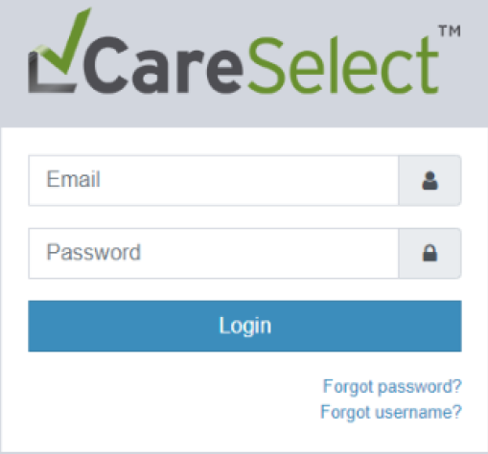
Open Access Registration
Complete the Open Access registration form at:
  http://openaccess.careselect.org/registration
  Basic information needed: name, e-mail, NPI, role, and organization name and type.
Open the confirmation email and follow steps to confirm your account.
Login to https://openaccess.careselect.org and enter the username and password created during registration.

Slide 4
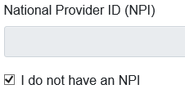
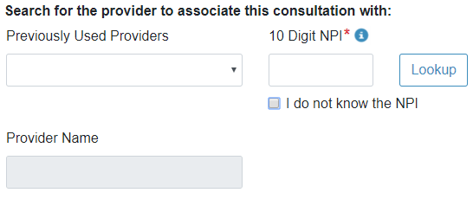
Non-NPI Providers
If you do not have an NPI number, click the checkbox next to I do not have an NPI.
Before you begin consulting CDS, enter the ordering provider’s NPI. If you do not know the provider’s NPI, click the checkbox. Then, enter the provider’s name.

Slide 5
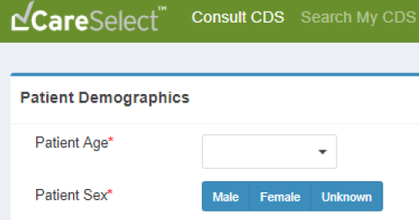
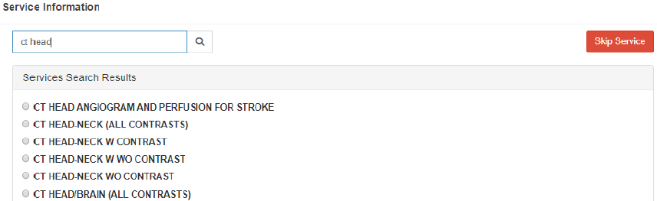
Consult CDS
To begin consulting, click Consult CDS and input the patient’s age and sex.
Search for the appropriate exam in the Service Information field.

Slide 6
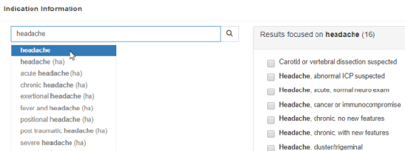
Find Appropriate Indication
Search for an Indication and select one or multiple indications.
A set of AUC displays for each indication, including: appropriateness rankings, relative costs, and relative radiation levels.
If you can’t find an indication, click and provide additional information.
When using the Can’t Find a Match workflow, your decision support session will not be evaluated for appropriateness.

Slide 7
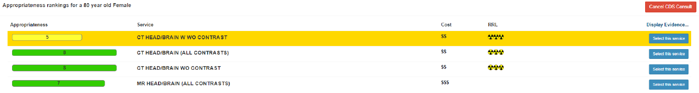
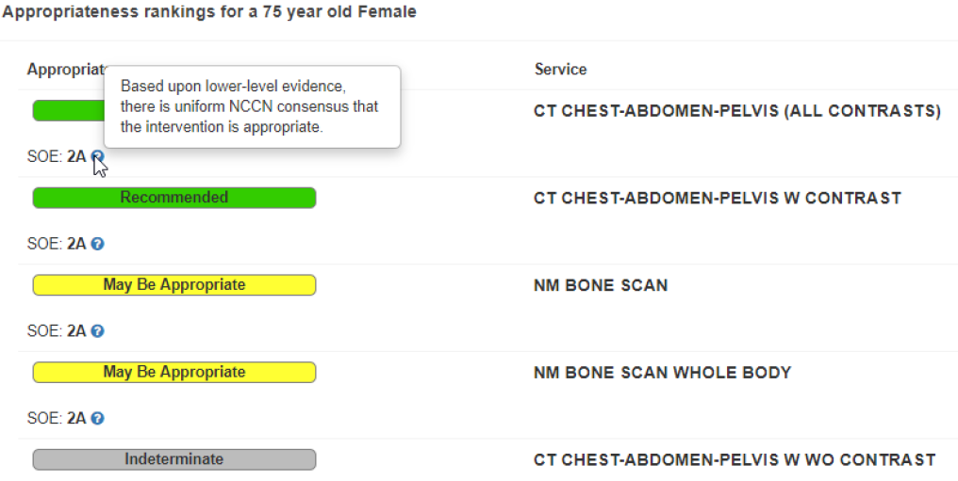
Complete CDS Consultation
Select a service from the available Appropriateness ranked AUC options. Services are ranked in order of appropriateness.
Image above represents how ACR (American College of Radiology) or SNMMI (Society of Nuclear Medicine and Molecular Imaging) content appropriateness rankings would display.
Image above represents how NCCN (National Comprehensive Cancer Network) or ACC (American College of Cardiology) content appropriateness ranking would display.

Slide 8
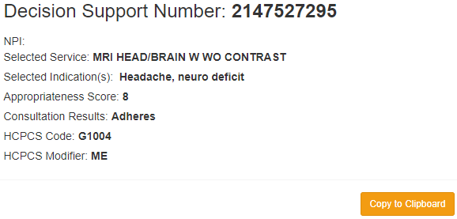
Consultation Confirmation
The Consultation Confirmation must be included with any orders referred to North Oaks.
Consultation Confirmation includes (but not limited to):
  Decision Support Number (DSN) –
    Used to verify AUC has been referenced
  HCPCS Code (i.e. the G-Code) and HCPCS Modifier
    Required for submission of claims to CMS
To search for any previous consultations, click Search My CDS Consultations.

